Slide 1
Wicked musical review
By Holly Angell
12th of November 2014

Slide 2
What evidence have I got that I went:
I have my ticket and official program as my evidence.

Slide 3
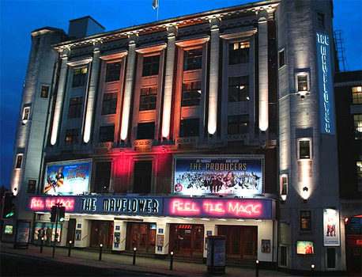
What happened at the arts event, what arts forms were involved :
The show Wicked involved singing, dancing and acting in the mayflower theatre, Southampton on stage.

Slide 4
Why I went to this event:
I went to the Wicked the musical as part of a school trip organized by Cranborne Middle School. Wicked the musical was on tour and visiting our local theatre in Southampton. I have seen several musicals including: Shrek and Matilda and I really enjoyed them so I was very exited about this school trip.
The things I liked and why:
I really liked the story because it showed how a good witch and a bad witch became friends and would sacrifice their own lives for each other. The story also help me connect the films The Great Man Of Oz and The Wizard Of Oz together. I really liked the costumes and lighting effects because they were very bright and created a frightful atmosphere which was very realistic and eye catching.

Slide 5
The things I didn’t like and why:
I didn’t really like the character The Great Oz who was a wizard who returned favours. The Great Oz had really creepy and piercing eyes that lit up the dark theatre. I found it very difficult to understand what The Great Oz was saying because his voice was so loud it made the words he was saying all muffled.
I would/would not recommend it to others because:
I would highly recommend the musical Wicked because the story was a mixture of happy and sad. The costumes were very realistic especially the bad witch called Elphaba who actually looked green! The music was very catchy, I knew 2 of the songs: Popular and Defying Gravity before I saw the show but it was good to see the songs being preformed live on stage. I really liked the song Dancing through life which was a new song to me and has a very catchy tune. I found the show Wicked very inspirational.

Slide 6
What I learnt from the experience :
I have learnt that watching a performance as a group with my friends is lots of fun because afterwards you can talk about the story, different costumes and favourite characters together. I also found the show helped me understand the connection between the 3 stories: The Great Man Of Oz, The Wizard Of Oz and now Wicked.
I plan to share this review with others by:
I plan to ask Mrs. Everett to put this review on the school website to share with the Cranborne Middle School community. I am also going to show this review with my family and recommend that they go and see the musical Wicked if they get the chance to.

Slide 7
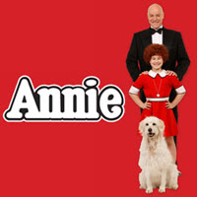
What event would I like to go and see next:
I would really like to go and see the musical Annie live on stage because I have already seen the film Annie on DVD staring: Albert Finney as “Daddy” Warbucks and Aileen Quinn as Annie and absolutely love the film. My favourite character in Annie is Sandy the mischievous dog who Annie found whilst walking in the street trying to find her mum whilst she was in a horrible orphanage. I would really like to see a well trained dog on stage in the Annie performance.

