Slide 1
Part B
Chelsea’s Choice
By Mollie Hatcher

Slide 2
Part B
For my Part B I have seen a production called Chelsea’s Choice. This is an educational piece of drama which is performed all over England. I witnessed this show on 10th March 2015 at Cranborne Middle School (my school) with the rest of year 8 and most of the teachers.
There was no ticket and we were not allowed to take pictures because of the content of the play.

Slide 3
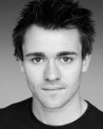
Actors
Chelsea’s Choice is performed by many different actors but the ones who came to our school were:
Christopher Laws
Franziska Brunzel-Roberts
Mitchell Snell
Alice Ferreira

Slide 4
What did I think?
I really liked the play because it really made me aware about the internet and the people around me and the acting was amazing. It was extremely overwhelming and it was very upsetting. It was for sure an experience I will never forget.
Out of 5 I would give it a ………

Slide 5
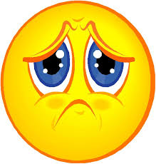
How did it make me feel?
The play made me feel frightened and upset. It is quite easy to make someone to feel upset, but the fact that it made me and other people scared and frightened was a challenge. It was also quite comical so it did make me laugh in some parts of it. It made me feel like this because the things included in this performance could happen to me.

Slide 6
What have I learnt
I have learnt that going on the internet or meeting up with people you don’t know can sometimes be dangerous and you should always make sure you are completely safe when online or just on the streets. But, you can still go on the internet, you don’t just have to never go on the internet again. It also makes me think twice about what I am putting online.

Slide 7
How it inspired me
Attending this arts event has inspired me to be more confident especially in my drama because the actors that came to our school were extremely confident and were so good at acting that it was actually making many people in the audience scared and worried for them.

Slide 8
Would I recommend it
I would recommend it because although it made me worried and frightened, it also made me feel safer in a way because I now know that it could happen and it has made me more aware about my surroundings. I would not recommend it to anyone younger than me though because it could be too overwhelming for them.

