Slide 1
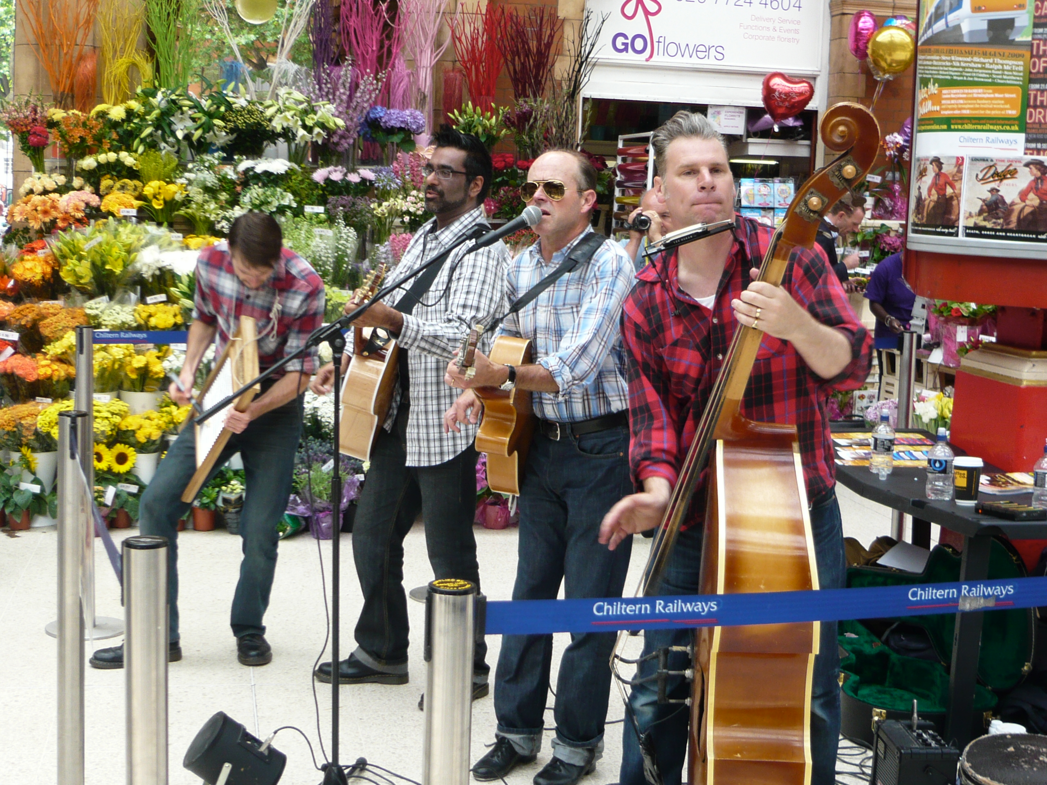
By Adam Hutchins

Slide 2
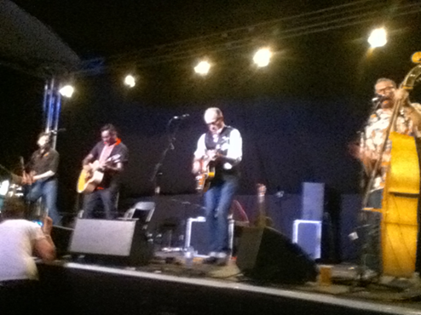
In 2014 I went to Larmer Tree Festival and saw a band who were a mixture of country blues, rockabilly and skiffle. They were called The Dodge Brothers. Before I had seen them I had never heard of them before. My mum had just told me they played rockabilly so I was interested. She had also told me that the famous movie critic, Mark Kermode, played double bass and sung backing vocals in the band.one thing I liked about the event was that afterwards I was able to meet them all and get my album signed by all of them, but what I disliked about it was the pictures came blurred.

Slide 3
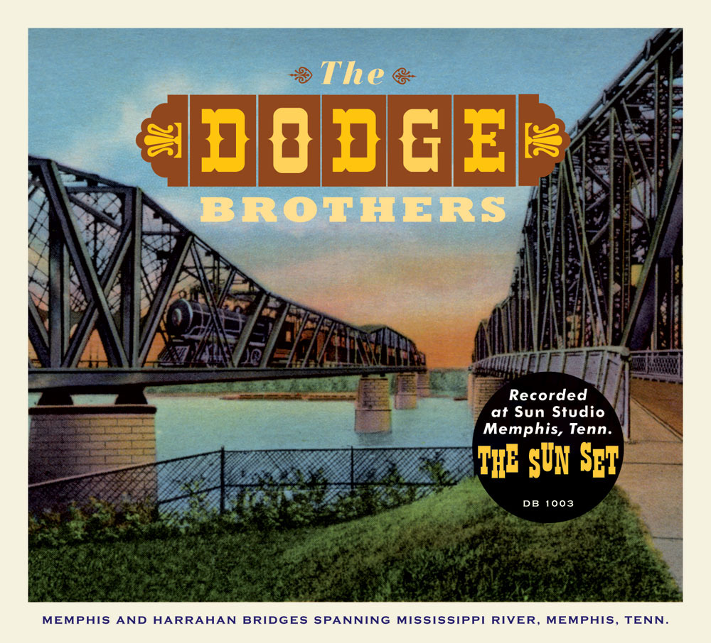
When I first saw them come on stage, I wasn’t expecting to see people so old. Once I saw them I was a bit prejudice and thought they’d be bad but when they started singing I realised how good they were. I could see how much everyone else was enjoying them because some people started dancing. From watching them perform I have learnt not to judge bands by how old they are or what they look like. I have also learnt that people still enjoy and are interested in much older music and are will listen to it. Watching them inspired me to watch more current rockabilly bands instead of just 1950s. All of my friends only really listen to what is currently on the charts, but if I had friends who listened to more types of music I would recommend it to them.

